Slide 1
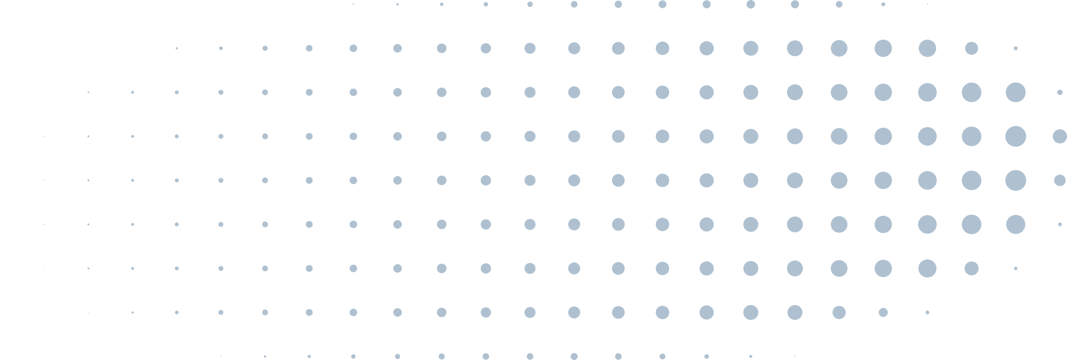
PREDICTING TISSUE STIFFNESS FROM MICROSCOPIC FIBER STRUCTURE IMAGES USING DEEP LEARNING
Omri Segev
Nofar Ogdan
Tel Aviv University | 2024

Slide 2
1
ABSTRACT
This project explores the feasibility of using deep learning to predict tissue stiffness, a crucial factor in biological processes, from readily available microscopic images of fiber structure. We compare the performance of two pre-trained models fine-tuned with limited data, highlighting the potential for non-invasive stiffness assessment.
Tel Aviv University | 2024

Slide 3
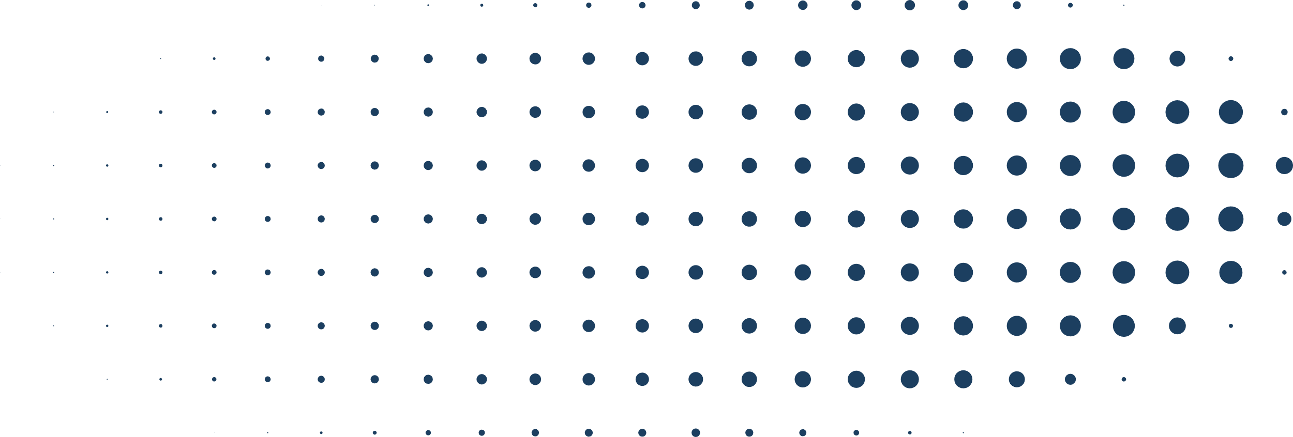
3
OVERVIEW
Introduction
Deep Learning Approach
Model Training
Tissue Stiffness Importance
Deep Learning for Prediction
LORA for Fine-tuning
Challenges and Motivation
Pre-trained Model
Training Sequences
Custom Model Architecture
Training Results
Conclusion
Tel Aviv University | 2024

Slide 4

4
INTRODUCTION
TISSUE STIFFNESS
1
Tissue stiffness, a crucial biomechanical property, quantifies a tissue's resistance to deformation under applied force. This intrinsic characteristic significantly impacts cellular and organ function.
Larana University | 2024
The stiffness of a tissue environment impacts how cells behave. It can influence how cells move around (migration), how they attach to surfaces (adhesion), and even how they specialize (differentiation).
2
3
Changes in tissue stiffness are associated with various diseases. In cancer, for example, stiffer tumor environments might promote tumor growth and spread. Understanding this connection could lead to new diagnostic and treatment strategies.

Slide 5
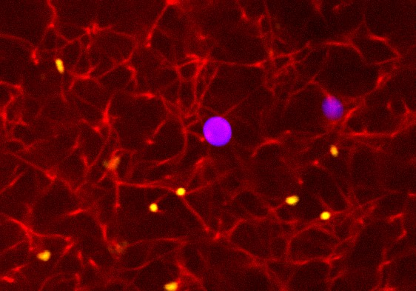
5
INTRODUCTION
STIFFNESS MEASURING CHALLENGES
1
Existing techniques (e.g., AFM, indentation tests, biopsies) are expensive, time-consuming, and often invasive and require specialized equipment.
Tel Aviv University | 2024
Optical microscopy offers a readily available, non-invasive way to visualize tissue structure, including the direction of stiffness-related fibers (key for stiffness).
2
3
AI model that predicts tissue stiffness directly from these microscopy images
would revolutionize stiffness measurement, enabling large-scale studies and a deeper understanding of mechanics in diseases like cancer.

Slide 6
6
PRE-TRAINED MODEL
THE DATA CONSTRAINT
The Challenge
Building a deep learning model to predict tissue stiffness from microscopic images is hampered by the limited availability of such images. This translates to a relatively small dataset for training the model. (Only 242 Samples)
Tel Aviv University | 2024
1
Training a deep learning model "from scratch" requires a vast amount of data.
With a limited dataset, the model might struggle to learn effectively, and the result will be overfitting.
2

Slide 7
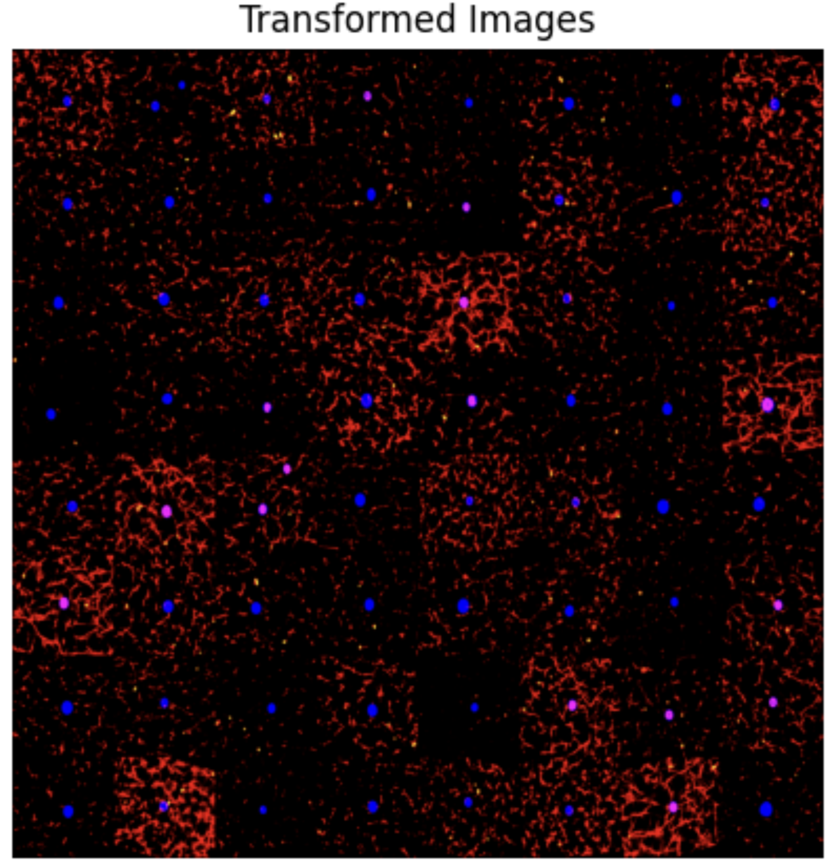
7
PRE-TRAINED MODEL
PRE-PROCESSING PIPELINE
To overcome the shortage of training data, the existing images were augmented on the fly during the pre-processing step inside the pipeline.
Tel Aviv University | 2024
Pre-processing includes random horizontal flip, random vertical flip, and normalization.

Slide 8
8
PRE-TRAINED MODELS
THE PRE-TRAINED MODEL
Feature | facebook/dinov2-base
Model Size | 86M Parameters
Main Components | Vision Transformer with Self-Attention
Original Task | Image Classification
Source | Facebook AI Research (2022)
Tel Aviv University | 2024

Slide 9
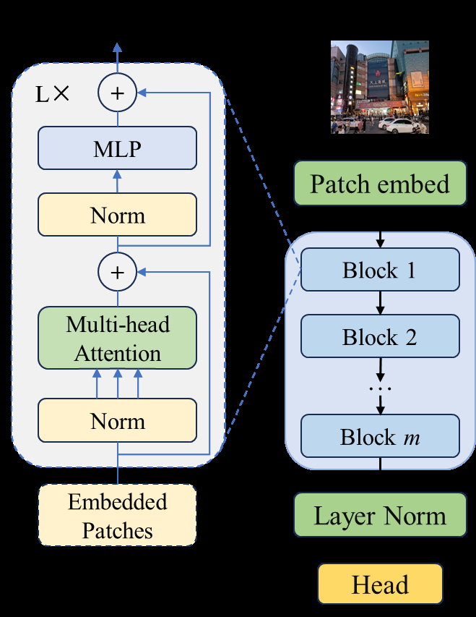
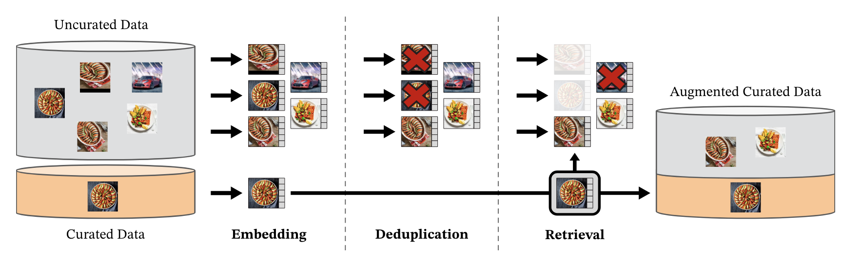
9
PRE-TRAINED MODEL
ARCHITECTURE
This powerful component acts as our feature extractor. Trained using discriminative self-supervised learning on a large amount of curated images, DINOv2 excels at identifying complex patterns and relationships within images.
Tel Aviv University | 2024

Slide 10
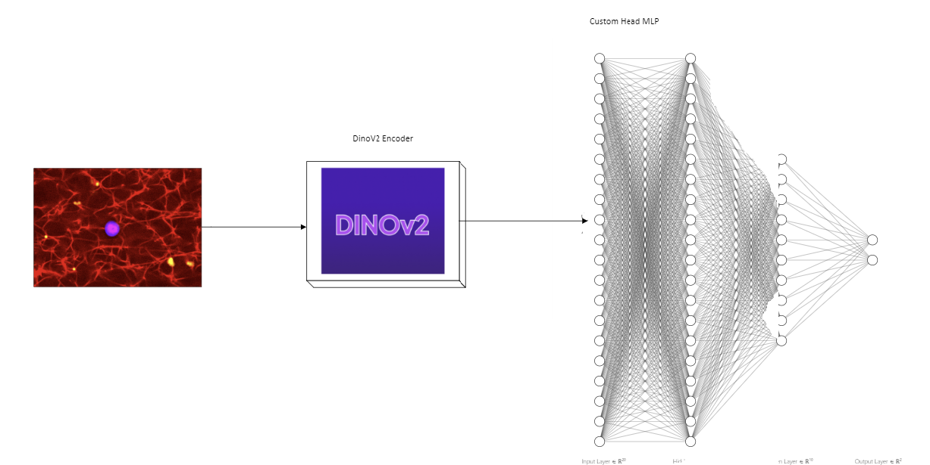
10
CUSTOM MODEL ARCHITECTURE
Building upon the rich features extracted by DINOv2, a custom 3 layers MLP acts as a translator.
This MLP takes a specific feature representation high-dimensional feature vector (associated with the [CLS] token from the last hidden layer of DINOv2) and transforms it into a prediction of the tissue stiffness.
Tel Aviv University | 2024

Slide 11
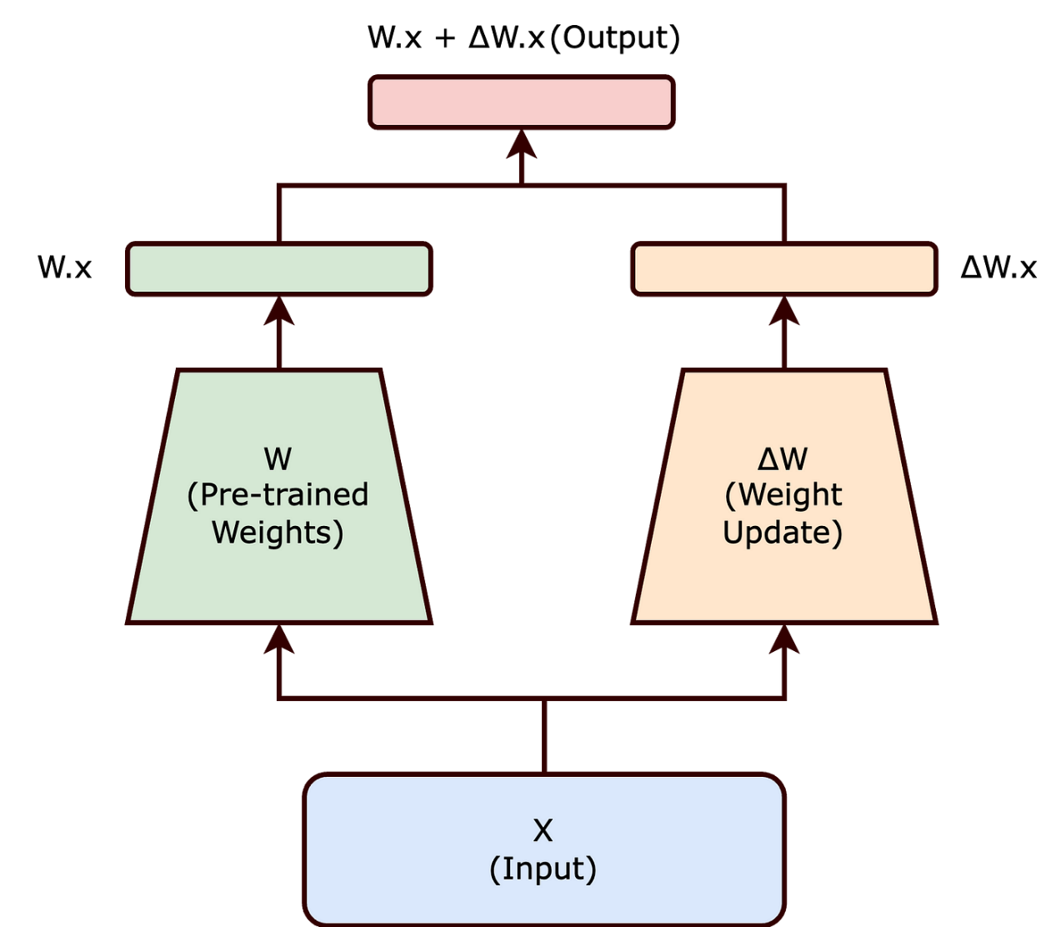
11
Model Training
FINE TUNING WITH LORA
Low-rank adaptation (LoRA) is an adapter-based technique for efficiently fine-tuning models.
1
Tel Aviv University | 2024
An "adapter" in this context is a collection of low-rank matrices, which when added to a base model, produces a fine-tuned model.
2
3
It allows for performance that approaches full-model fine-tuning with less space requirement

Slide 12

12
TRAINING SEQUENCES
We compare 3 forms o fine-tuning:
2 steps training :
1
1
MLP head trains
2
MLP head and DinoV2 fine-tuned
Tel Aviv University | 2024
2
Simultaneous: MLP trains and DinoV2 gets fine-tuned.
3
MLP head trains Only
Reversed 2 steps training :
4
1
MLP head trains and DinoV2 fine-tuned
2
MLP head trains

Slide 13
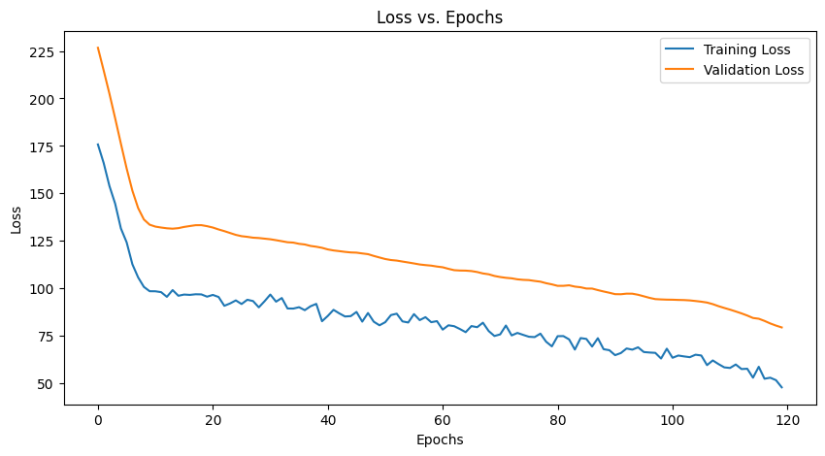
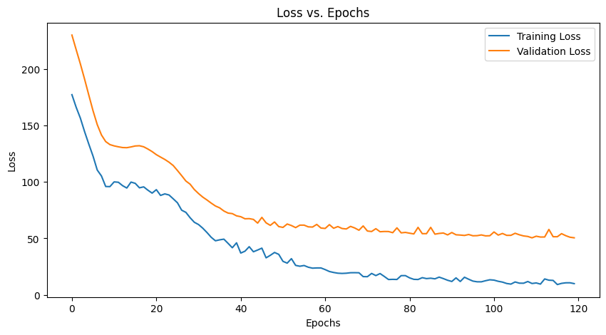
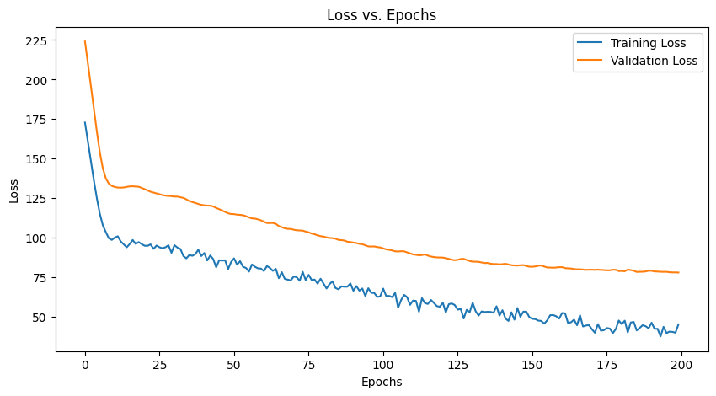
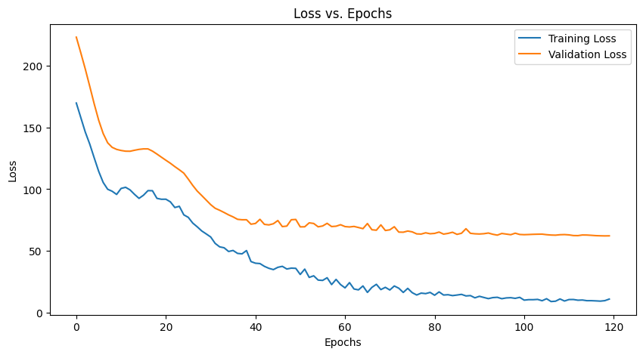
13
TRAINING RESULTS
2 steps training :
Reversed 2 steps training :
1
2
3
4
1
MLP trains and DinoV2 fine-tuned
1
MLP head trains
Simultaneous
MLP head trains Only
2
2
MLP head trains
MLP and DinoV2 fine-tuned
Tel Aviv University | 2024

Slide 14

14
TRAINING RESULTS
 | 1. 2 Steps | 2. Simultaneous | 3. MLP head Training Only | 4. Reversed 2 steps
Epochs | 100+20 | 120 | 200 | 100+20
Final Training MSE | 47.88 | 9.9369 | 45.3172 | 10.8176
Final Validation MSE | 79.4 | 50.4879 | 78.0882 | 62.1288
Relative MSE to Stiffness L2 Norm | 233% | 185.77% | 231% | 206%
$Relative Error$ $=\frac{\sqrt{MSE}}{|\left|stiffness\right||}$
Tel Aviv University | 2024

Slide 15
15
Conclusions
The DINOv2 model struggled with our limited data. Instead of learning from the data, it just memorized it.
1
Expand Data Augmentation: Trying more techniques (cropping, resizing and elastic transformations) might vary more the limited dataset.
Tel Aviv University | 2024
Replace DinoV2 with smaller architecture: A smaller model has fewer parameters to adjust during training, so it will reduce the risk of overfitting
2
Use Unlabeled Data with Self-Supervised Learning: Enhancing feature extraction ability from unlabeled tissue images(For example, training the model to distinguish between slightly rotated versions of the same image).
3

Slide 16
Tel Aviv University | 2024
THANK YOU
Presented By :
Omri Segev Nofar Ogdan

